Slide 1
Keypad Scanning Hardware and Assembler Software
Prof. Ken Short
© Copyright Kenneth Short 2006
Notes:
03 Keypad Scanning Hardware and ASM Code
© Copyright Kenneth Short 2005

Slide 2
Agenda
Basic Scanning Concept
Hardware vs Software Scanning
74C922/3 Hardware Scanner ICs
AVR240 4 x 4 keypad design
AVR240 software
© Copyright Kenneth Short 2006
Notes:
03 Keypad Scanning Hardware and ASM Code
© Copyright Kenneth Short 2005

Slide 3
Embedded Systems’ User Interface
Most, but not all, embedded systems have a user interface
A user interface allows a user to enter commands and data to the embedded system and to receive status and results from the system
Switches, keypads, keyboards, and rotary encoders are common user input devices
Individual LEDs, seven-segment LED displays, liquid crystal displays, and vacuum fluorescent displays are common user output devices
© Copyright Kenneth Short 2006
Notes:
03 Keypad Scanning Hardware and ASM Code
© Copyright Kenneth Short 2005

Slide 4
User Input
Switches
Pushbuttons
Keypads
Rotary Encoders - Optical and Mechanical
© Copyright Kenneth Short 2006
Notes:
03 Keypad Scanning Hardware and ASM Code
© Copyright Kenneth Short 2005

Slide 5
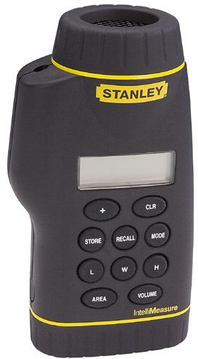
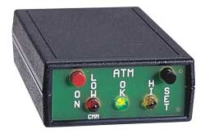

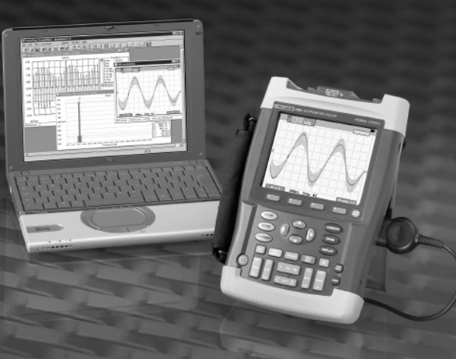
Simple User Input Examples
© Copyright Kenneth Short 2006
Notes:
03 Keypad Scanning Hardware and ASM Code
© Copyright Kenneth Short 2005

Slide 6
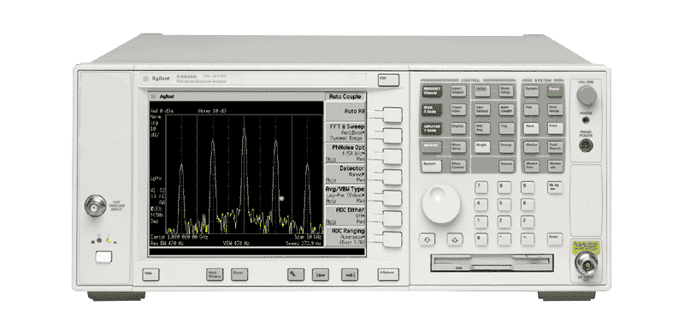
A Front Panel for A Complex Instrument
© Copyright Kenneth Short 2006
Notes:
03 Keypad Scanning Hardware and ASM Code
© Copyright Kenneth Short 2005

Slide 7
Required Operations
Provision of appropriate digital input data may require one or more of the following operations:
  Conversion: distinguishing between the two logic states of an input device and generating an electrical signal with the appropriate voltage to represent each state
  Sensing: detecting a change in state of an input signal corresponding to the occurrence of new data
  Debouncing: providing a single transition for each change of state of a mechanical switch
  Encoding: converting a multivalued input state to a binary code
© Copyright Kenneth Short 2006
Notes:
03 Keypad Scanning Hardware and ASM Code
© Copyright Kenneth Short 2005

Slide 8
Hardware/software Tradeoffs
Techniques for carrying out these operations vary considerably depending on the physical nature of each input device
Usually, there are considerable opportunites for hardware/software tradeoffs
The preference when using microcontrollers in low cost systems is usually a software approach
© Copyright Kenneth Short 2006
Notes:
03 Keypad Scanning Hardware and ASM Code
© Copyright Kenneth Short 2005

Slide 9
Connecting Multiple Keys to Microcontroller
Linear Unencoded: each key requires a port pin, n keys requires n port pins.
Linear Externally Encoded: an encoder IC takes n inputs and creates ⎡log2 n⎤ outputs. ⎡Log2 n⎤ port pins required.
R × C Matrix Unencoded: n = r × c keys requires r + c port pins.
R × C Matrix Externally Encoded: A scanner/encoder IC takes r × c inputs and creates ⎡Log2 r⎤ + ⎡Log2 c⎤ outputs. ⎡Log2 r⎤ + ⎡Log2 c⎤ port pins required
© Copyright Kenneth Short 2006
Notes:
03 Keypad Scanning Hardware and ASM Code
© Copyright Kenneth Short 2005

Slide 10
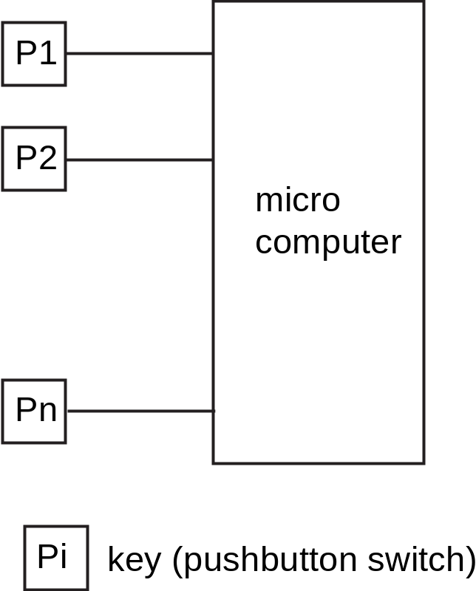
Linear Unencoded Keys
© Copyright Kenneth Short 2006
Notes:
03 Keypad Scanning Hardware and ASM Code
© Copyright Kenneth Short 2005

Slide 11
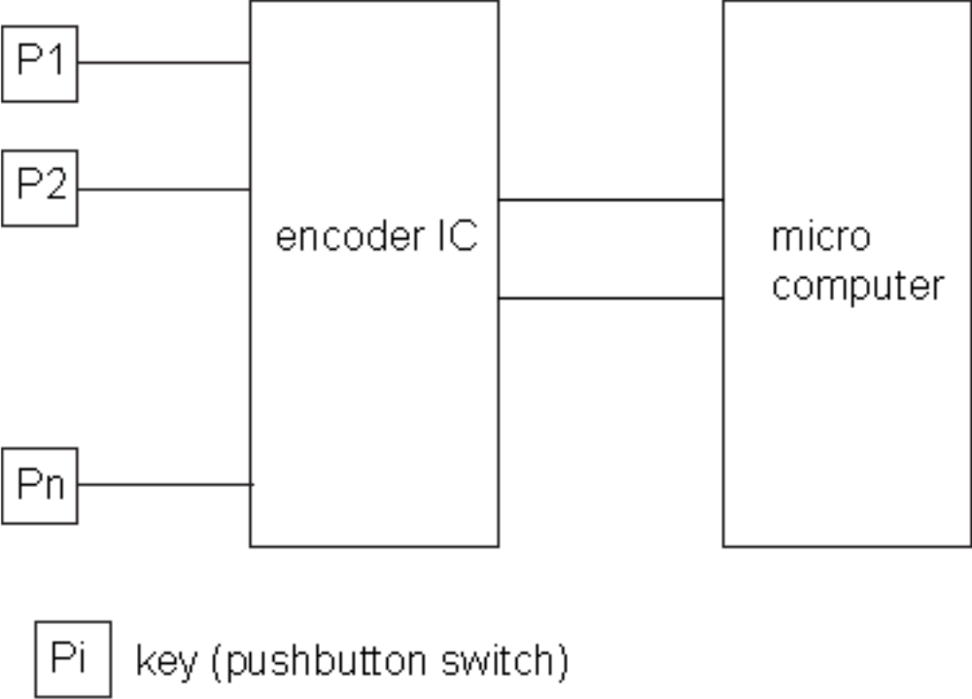
Linear Externally Encoded Keys
© Copyright Kenneth Short 2006
Notes:
03 Keypad Scanning Hardware and ASM Code
© Copyright Kenneth Short 2005

Slide 12
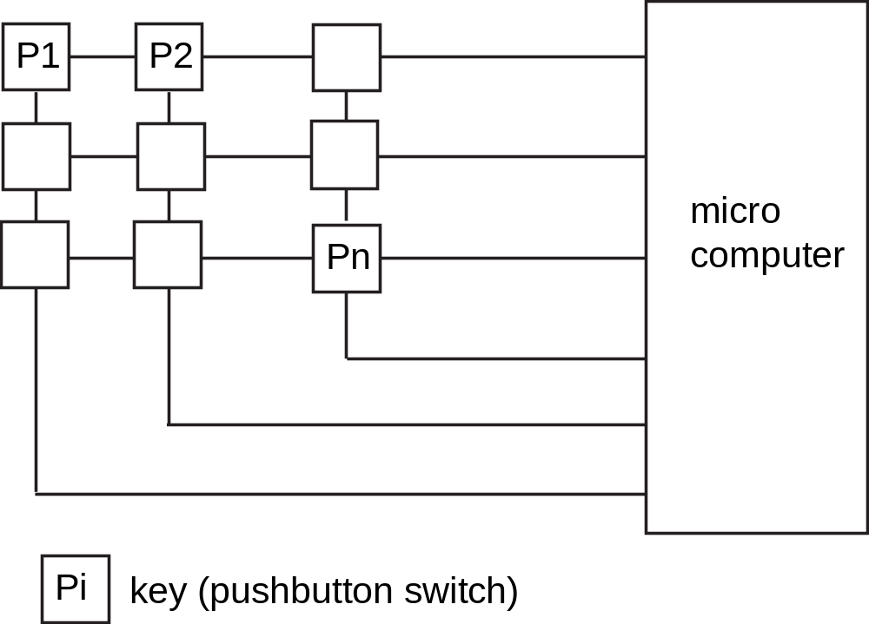
Matrix Unencoded Keys
© Copyright Kenneth Short 2006
Notes:
03 Keypad Scanning Hardware and ASM Code
© Copyright Kenneth Short 2005

Slide 13
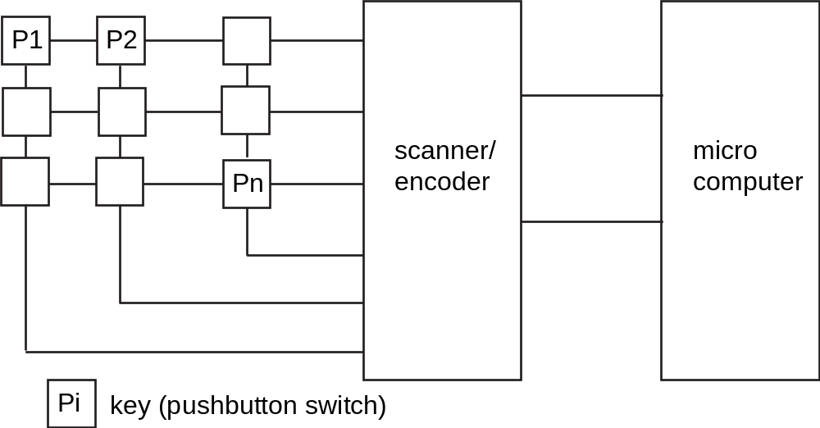
Externally Encoded Matrix
© Copyright Kenneth Short 2006
Notes:
03 Keypad Scanning Hardware and ASM Code
© Copyright Kenneth Short 2005

Slide 14
Matrix Scanning
A matrix must be scanned to identify which key is pressed.
Pressing a key in a matrix connects the row and column that intersect the key’s position.
There are two basic scan approaches depending on whether the direction of the ports that drive the rows and columns are fixed or changeable (bidirectional)
© Copyright Kenneth Short 2006
Notes:
03 Keypad Scanning Hardware and ASM Code
© Copyright Kenneth Short 2005

Slide 15
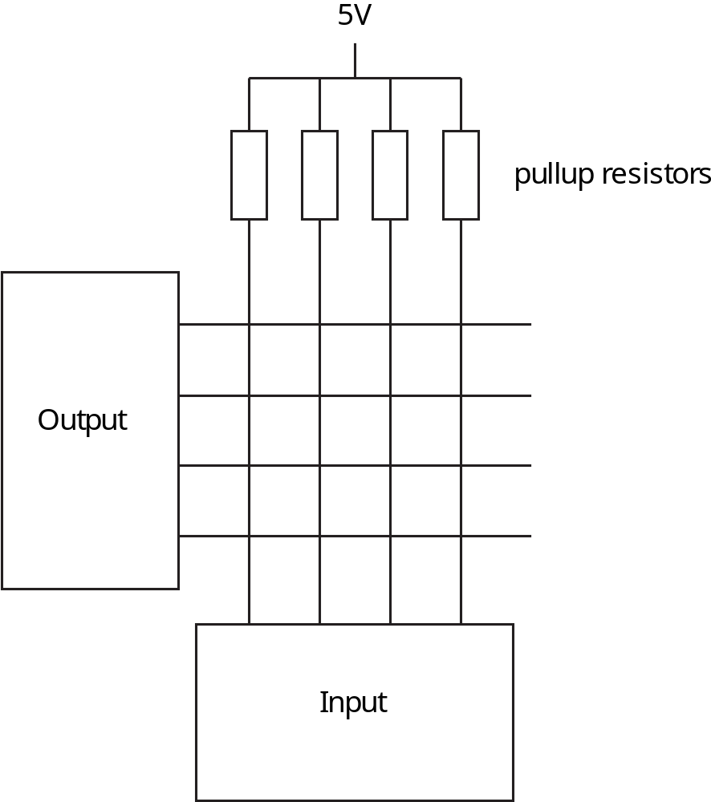
Scanning with Fixed Port Directions
© Copyright Kenneth Short 2006
Notes:
03 Keypad Scanning Hardware and ASM Code
© Copyright Kenneth Short 2005

Slide 16
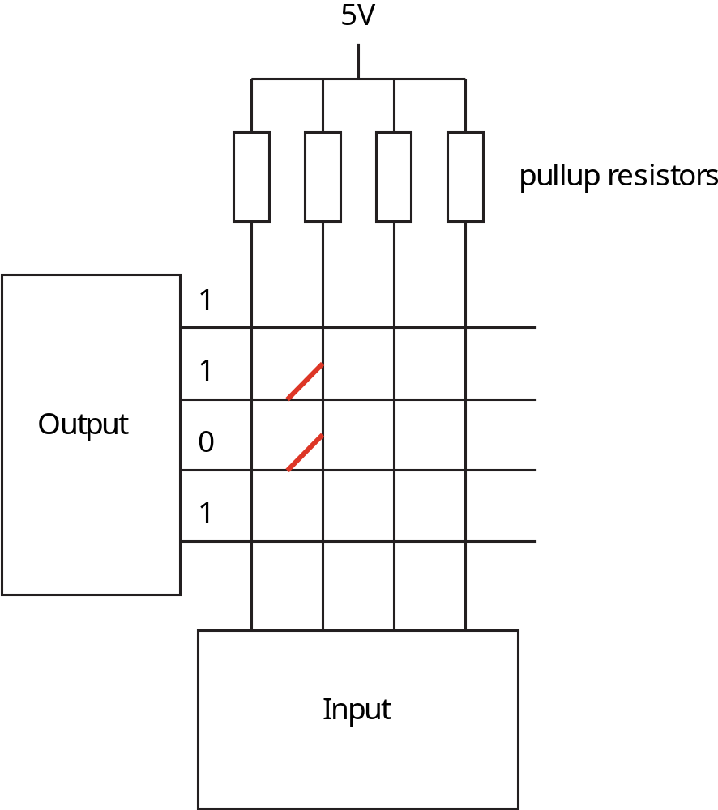
Scanning Issues – Multiple Key Short
© Copyright Kenneth Short 2006
Notes:
03 Keypad Scanning Hardware and ASM Code
© Copyright Kenneth Short 2005

Slide 17
Solution
Isolation diodes can solve two key short problem. But it requires and isolation diode for each row.
© Copyright Kenneth Short 2006
Notes:
03 Keypad Scanning Hardware and ASM Code
© Copyright Kenneth Short 2005

Slide 18
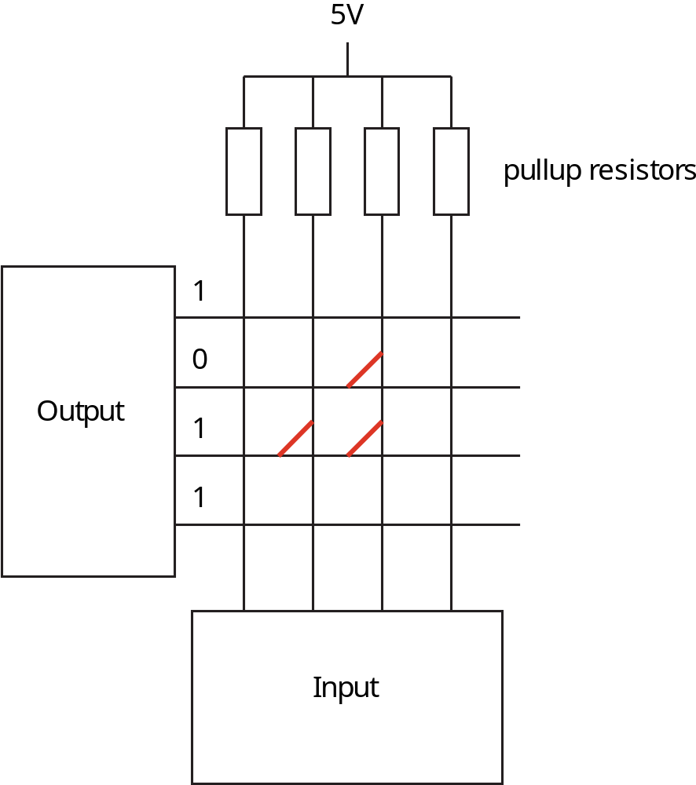
Scanning Issues – Phantom Key
© Copyright Kenneth Short 2006
Notes:
03 Keypad Scanning Hardware and ASM Code
© Copyright Kenneth Short 2005

Slide 19
Solution
Isolation diodes can solve phantom key problem. But it requires and isolation diode for each intersection.
© Copyright Kenneth Short 2006
Notes:
03 Keypad Scanning Hardware and ASM Code
© Copyright Kenneth Short 2005

Slide 20
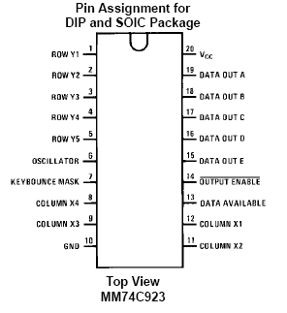
Hardware Scanner – 74C922/3
© Copyright Kenneth Short 2006
Notes:
03 Keypad Scanning Hardware and ASM Code
© Copyright Kenneth Short 2005

Slide 21
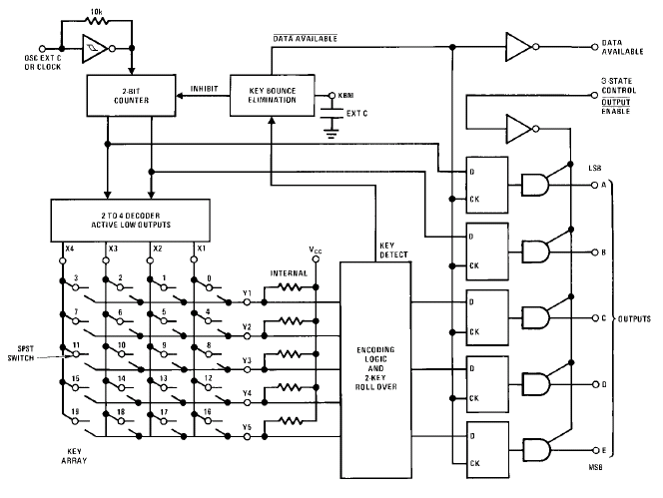
74C922/3 Logic Diagram
© Copyright Kenneth Short 2006
Notes:
03 Keypad Scanning Hardware and ASM Code
© Copyright Kenneth Short 2005

Slide 22
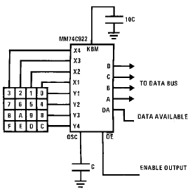
74C922/3 Application
© Copyright Kenneth Short 2006
Notes:
03 Keypad Scanning Hardware and ASM Code
© Copyright Kenneth Short 2005

Slide 23
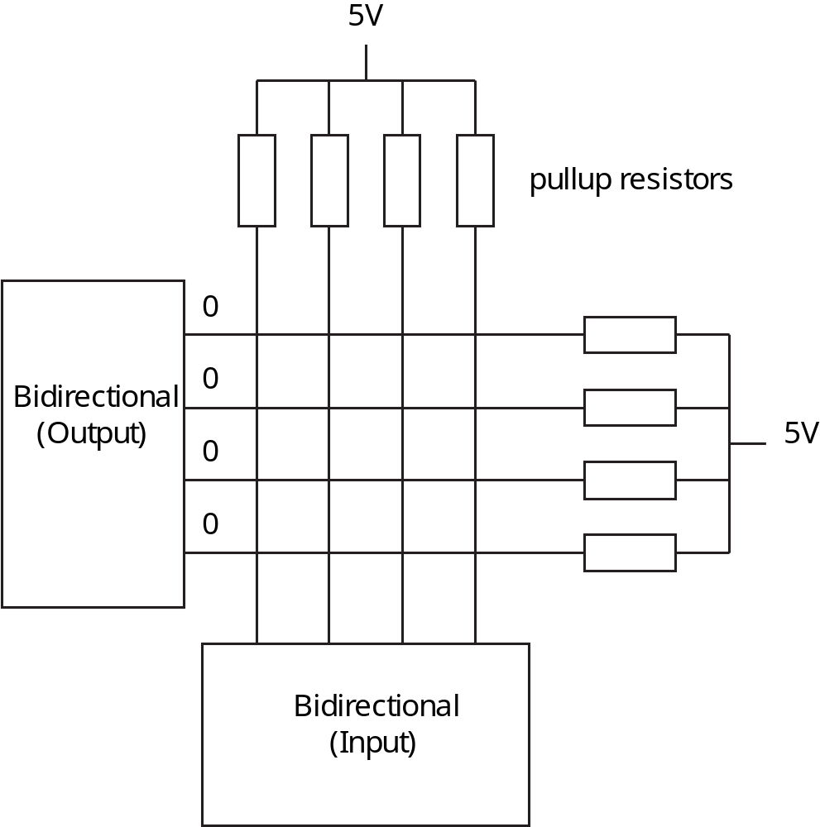
Bidirectional Port – Column Determination
© Copyright Kenneth Short 2006
Notes:
03 Keypad Scanning Hardware and ASM Code
© Copyright Kenneth Short 2005

Slide 24
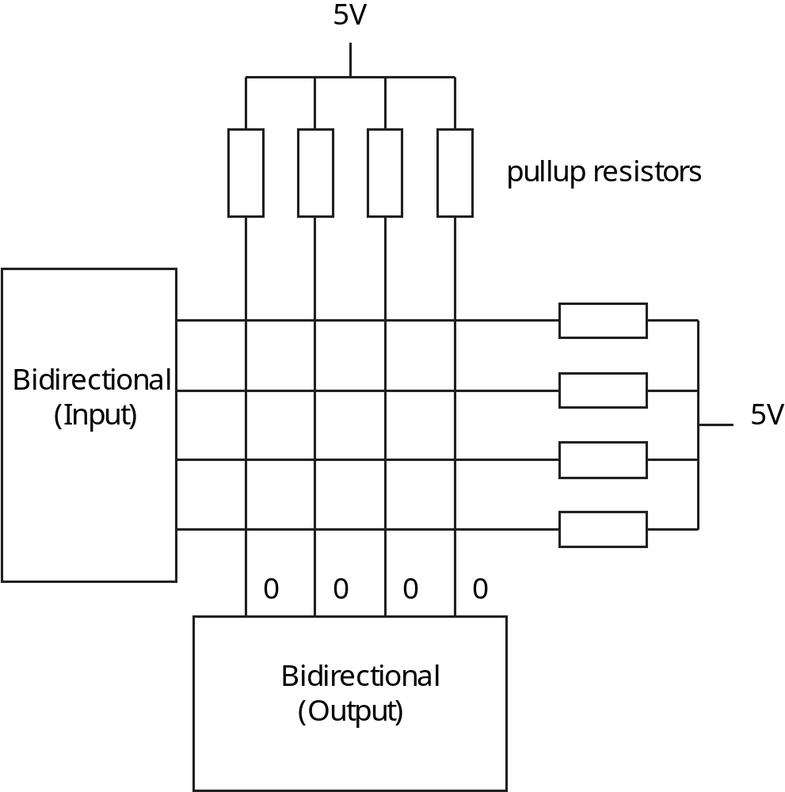
Bidirectional Port – Row Determination
© Copyright Kenneth Short 2006
Notes:
03 Keypad Scanning Hardware and ASM Code
© Copyright Kenneth Short 2005

Slide 25
Basic Features of the AVR240 Design
Atmel’s application note AVR240 describes a circuit and software for keypad scanning that uses minimal hardware. See the AVR240 Application Note on Blackboard for the actual assembler code.
16 Key Pushbutton Keypad in 4 x 4 Matrix
Very Low Power Consumption
AVR operated in Sleep Mode and Wakes Up on Keypress
Minimum External Components
ESD Protection Included, if Necessary
Efficient Code
Complete Program Included for AT90S1200
Suitable for Any AVR MCU
© Copyright Kenneth Short 2006
Notes:
03 Keypad Scanning Hardware and ASM Code
© Copyright Kenneth Short 2005

Slide 26
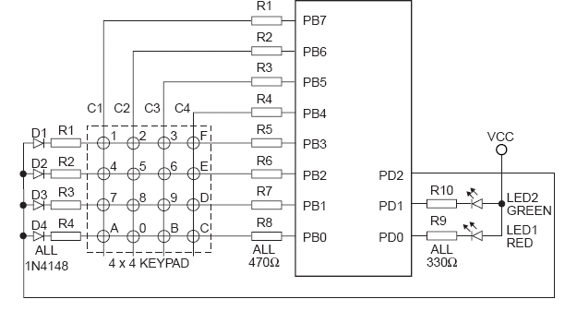
AVR240 Keypad and LED Connections
R1 – R8 for ESD
protection
© Copyright Kenneth Short 2006
Notes:
03 Keypad Scanning Hardware and ASM Code
© Copyright Kenneth Short 2005

Slide 27
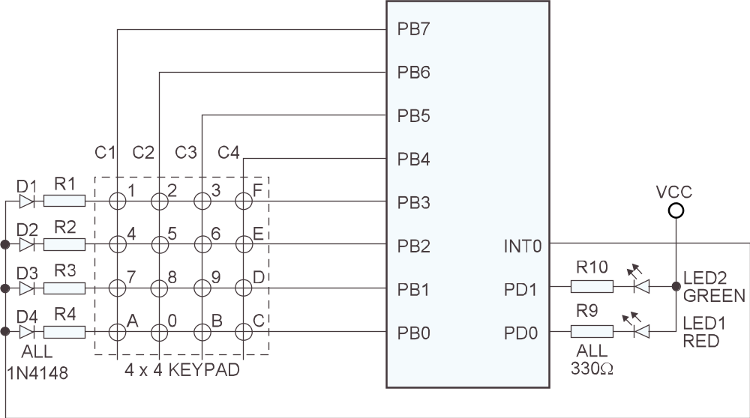
Circuit Without ESD Protection
© Copyright Kenneth Short 2006
Notes:
03 Keypad Scanning Hardware and ASM Code
© Copyright Kenneth Short 2005

Slide 28
Basic AVR240 Algorithm Operation
Software initializes ports and then puts AVR in sleep mode
Key press generates interrupt
Interrupt service routine scans keypad and returns key value
Test program uses value returned to determine which LED to flash and how many times to flash LED
© Copyright Kenneth Short 2006
Notes:
03 Keypad Scanning Hardware and ASM Code
© Copyright Kenneth Short 2005

Slide 29
Analyze Voltage Levels
What value is needed for R1 through R4? Is the 470 ohm value used in the schematic appropriate when the keypad is connected to an ATmega128?
Does a key press generate a valid active low logic value to INT0?
Data to answer this requires use of information in the DC electrical characteristics of the ATmega128 data sheet (page 318)
© Copyright Kenneth Short 2006
Notes:
03 Keypad Scanning Hardware and ASM Code
© Copyright Kenneth Short 2005

Slide 30
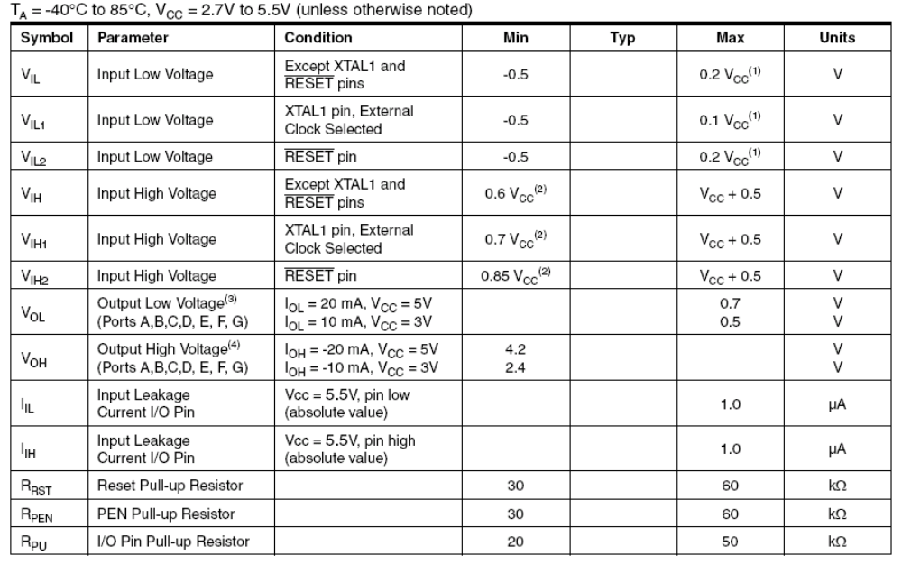
ATmega128 DC Electrical Characteristics
© Copyright Kenneth Short 2006
Notes:
03 Keypad Scanning Hardware and ASM Code
© Copyright Kenneth Short 2005

Slide 31
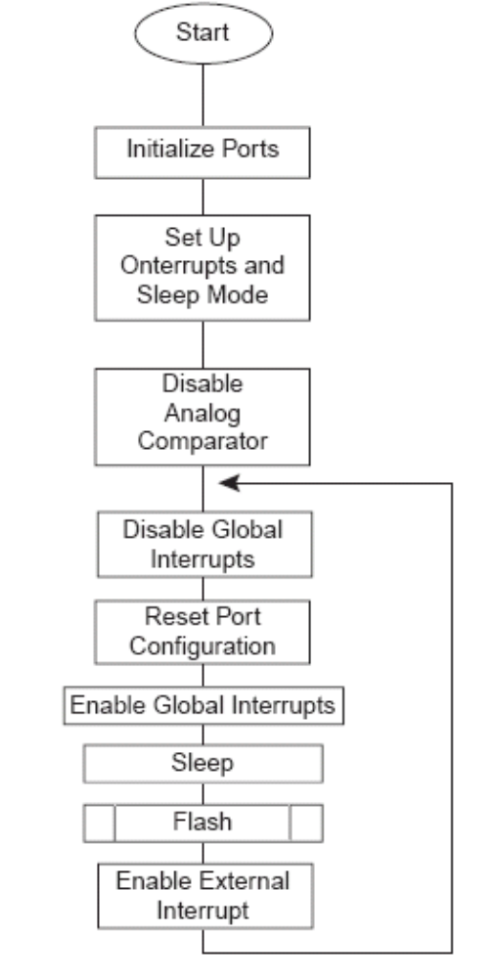
AVR240 Flowchart
Flowchart for reset
and main routine
key press interrupt
© Copyright Kenneth Short 2006
Notes:
03 Keypad Scanning Hardware and ASM Code
© Copyright Kenneth Short 2005

Slide 32
Port Initialization
0
0
PB7 – PB4 outputs
PB3 – PB0 inputs
With pull-ups enabled
0
0
INT0 has pull-up
enabled and is configured
for level triggered interrupt
© Copyright Kenneth Short 2006
Notes:
03 Keypad Scanning Hardware and ASM Code
© Copyright Kenneth Short 2005

Slide 33
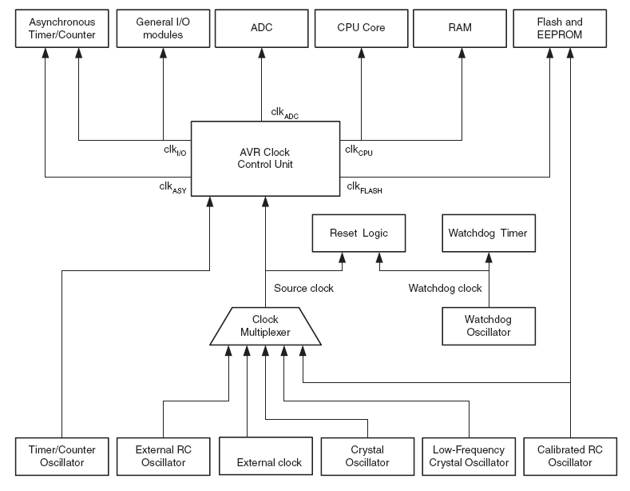
Clock Distribution
© Copyright Kenneth Short 2006
Notes:
03 Keypad Scanning Hardware and ASM Code
© Copyright Kenneth Short 2005

Slide 34
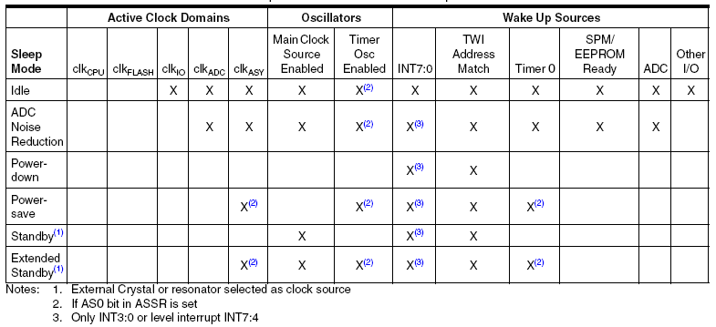
Active Clock Domains and Wake Up Sources
© Copyright Kenneth Short 2006
Notes:
03 Keypad Scanning Hardware and ASM Code
© Copyright Kenneth Short 2005

Slide 35
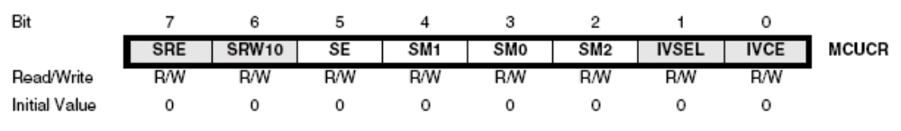
Sleep Mode
The SE (sleep enable) bit must be written to logic one to make the MCU enter the Sleep mode when the SLEEP instruction is executed
Bits SM0, SM1, and SM2 select which sleep mode
© Copyright Kenneth Short 2006
Notes:
03 Keypad Scanning Hardware and ASM Code
© Copyright Kenneth Short 2005

Slide 36
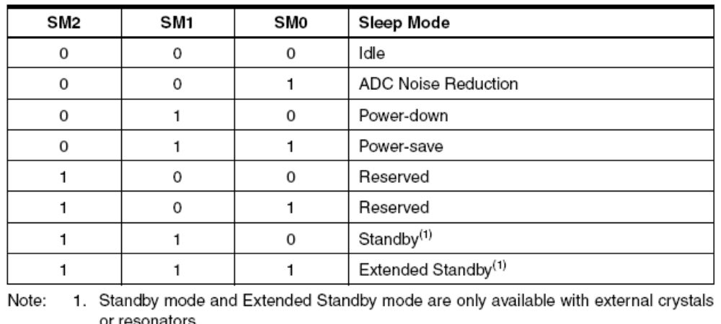
Sleep Mode Select
© Copyright Kenneth Short 2006
Notes:
03 Keypad Scanning Hardware and ASM Code
© Copyright Kenneth Short 2005

Slide 37
Keypress Interrupt Wakes up AVR
0
0
PB7 – PB4 outputs
PB3 – PB0 inputs, with
pull-ups enabled
0
0
INT0 has pull-up
enabled and is configured
for level triggered interrupt
© Copyright Kenneth Short 2006
Notes:
03 Keypad Scanning Hardware and ASM Code
© Copyright Kenneth Short 2005

Slide 38
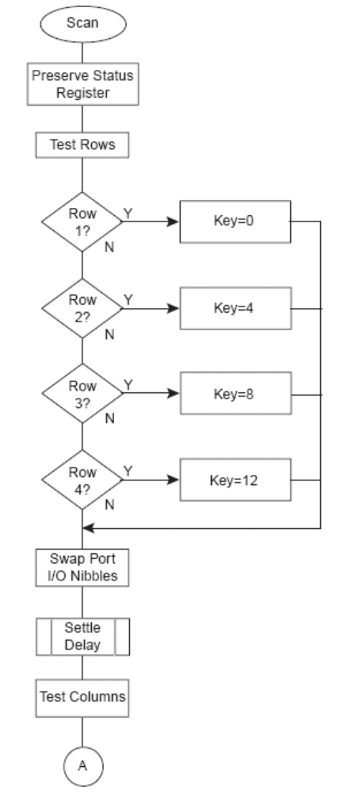
Flowchart for Interrupt Service Routine
© Copyright Kenneth Short 2006
Notes:
03 Keypad Scanning Hardware and ASM Code
© Copyright Kenneth Short 2005

Slide 39
Scan - Test Rows
0
0
PB7 – PB4 outputs
PB3 – PB0 inputs
With pull-ups enabled
0
0
INT0 has pull-ups
enabled and is configured
for level triggered interrupt
© Copyright Kenneth Short 2006
Notes:
03 Keypad Scanning Hardware and ASM Code
© Copyright Kenneth Short 2005

Slide 40
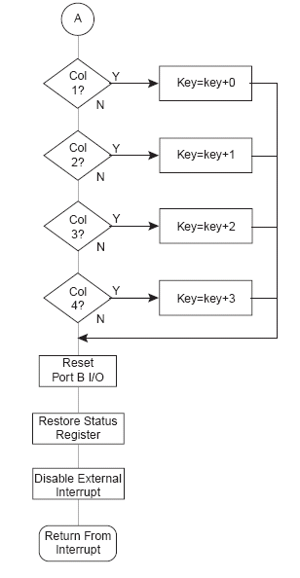
Interrupt Service Routine Continued
© Copyright Kenneth Short 2006
Notes:
03 Keypad Scanning Hardware and ASM Code
© Copyright Kenneth Short 2005

Slide 41
Test Columns
PB7 – PB4 inputs
With pull-ups enabled
PB3 – PB0 outputs
0
0
0
0
© Copyright Kenneth Short 2006
Notes:
03 Keypad Scanning Hardware and ASM Code
© Copyright Kenneth Short 2005

Slide 42
Next Class
C Software keypad scanning and debouncing for AVR Architecture
© Copyright Kenneth Short 2006
Notes:
03 Keypad Scanning Hardware and ASM Code
© Copyright Kenneth Short 2005

Slide 43
Reading Assignment
C code to scan keypad (keypad.c)
© Copyright Kenneth Short 2006
Notes:
03 Keypad Scanning Hardware and ASM Code
© Copyright Kenneth Short 2005

